Slide 1
Mall Customers
By Sheri Dutter,
Thinkful
November 2021
Notes:
Today we will be discussing an analysis conducted on mall customers who have memberships.

Slide 2
CONTENTS
01
Introduction
02
Hypothesis Test 1
Female compared to Male Spending
03
Hypothesis Test 2
Spending of customers in 30s compared to 40s
04
Recommendation
Review test results and provide recommendations
05
Next Steps and Q&A
06
Appendix
Links to data and Colab notebook
Notes:
First, we will go through a brief introduction, then we will move into reviewing the two hypothesis tests conducted followed by recommendations based on the test results. Lastly, we will talk about possible next steps and any questions will be answered.

Slide 3
01
Introduction

Slide 4
Introduction
Research conducted
Data Source
    Data description
Objective
Analysis
    Software used for analysis
Hypothesis Tests
    Testing method
    Measurement
Notes:
When researching data to use for this project, Kaggle.com, data.gov and data-is-plural.com websites were reviewed. The criteria I used for selecting a dataset was: something that was interesting, a file that had enough data allowing two hypothesis tests to be performed, how recently the data was updated or added to the site and the cleanliness of the data.
After reviewing these sites, the mall customers dataset from Kaggle’s website was used to conduct the analyses. The file contains 200 rows of mall customers who have a membership at the mall and five columns which include CustomerID, gender, age, annual income and spending score. The Spending Score is assigned by the mall based on customer behavior and spending nature. The file was also clean and did not have any null values.
The objective of this project is to analyze customer demographics with data from the mall’s customers who have membership cards to understand who is shopping at the mall, who to target and how to target current and future customers.
The data was first analyzed in Excel to determine the data to use for the hypothesis tests. The analyses were then conducted by importing the file into Python and using Python’s Pandas to review the data and run the hypothesis tests.
Two hypothesis tests were preformed: male vs female spending and spending by age group. To conduct the hypothesis tests a t-test was used to determine whether Ho: There is not a significant difference in spending between the two groups being tested or Ha: There is statistical difference between the two testing groups.

Slide 5
02
Hypothesis Test 1
Notes:
We will now review the first hypothesis test performed which was spending between males and females.

Slide 6
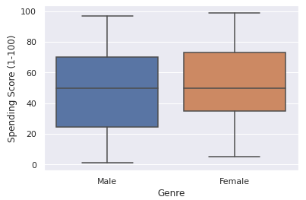
Hypothesis Tests
Hypothesis Test 1
Male vs Female
  Objective
  Hypothesis Test
  Results
  Recommendation
Notes:
The first hypothesis test compared spending between males and females. The objective of this test is to confirm or dispel the popular thought that females spend more than males and to provide recommendations on whether one should be more heavily promoted over the other.
To conduct the hypothesis test, a t-test was used to determine whether Ho: There isn’t a significant difference between male and female spending or Ha: There is statistical difference between male and female spending.
The results shown by the box plot on this slide is that there isn’t a statistical difference between the spending habits of males and females. The p value of 0.4137 also shows there is no significant difference in the probability of females spending more than males.
This test will change the minds of everyone who believes females spend more than males and will provide valuable insight to the mall and its stores. From a business perspective, it shows that the mall and mall stores will be profitable by targeting both males and females.

Slide 7
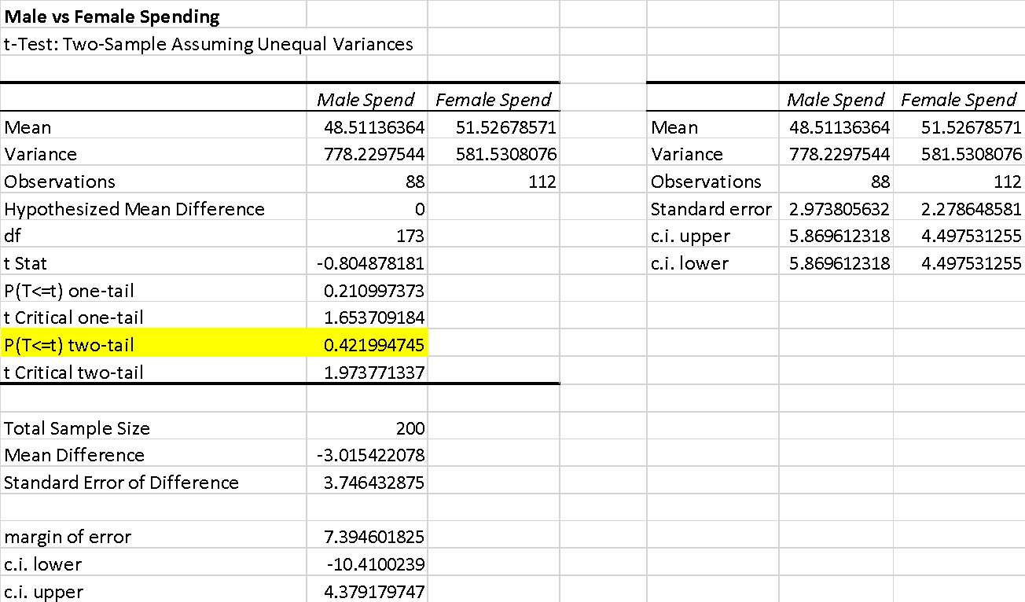
Additional statistical results
Hypothesis Test 1: Male vs Female

Slide 8
03
Hypothesis Test 2
Notes:
We will now review the second hypothesis test performed which was based on age groups.

Slide 9
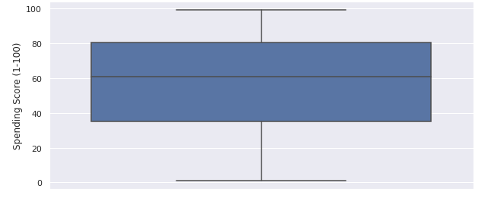
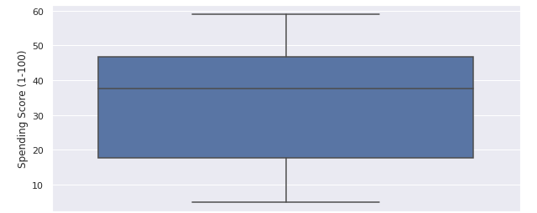
Hypothesis Tests
Hypothesis Test 2
Age Groups
  Objective
  Hypothesis Test
  Results
  Recommendation
Thirties
Forties
Notes:
When it comes to what age group spends the most, I felt people in their 30s spend more than those in their 40s because they have families with young children, have established their career enough to have a good salary, have tenure at the company where they work and even if they are single, they will likely be homeowners who need/want to buy things for their house/apartment.
The objective of this test is to determine which age range spends more and to provide recommendations on whether one should be more heavily promoted over the other.
After reviewing the data in Excel, a t-test was used to conduct the hypothesis test on spending between ages 31-40/those in their Thirties to ages 41-50/those in their Forties in order to determine whether or not there is statistical difference in spending between the two age groups
The box plot on this slide shows that there is statistical difference between the spending habits of those in their 30s compared to those in their 40s. This test also had a very low p value. Based on these results, I can reject the null that there is no difference between the spending score of those in their 30s compared to those in their 40s.
This results of this test shows that those in their 30s, regardless of gender, have a higher spending score over those in their 40s, which confirms my initial predicted results. This analysis will allow the mall and the mall stores to know who to best target when purchasing product and in their advertising. From a business perspective, it shows that the mall will be more profitable by bringing in stores with products targeting those in their 30s.

Slide 10
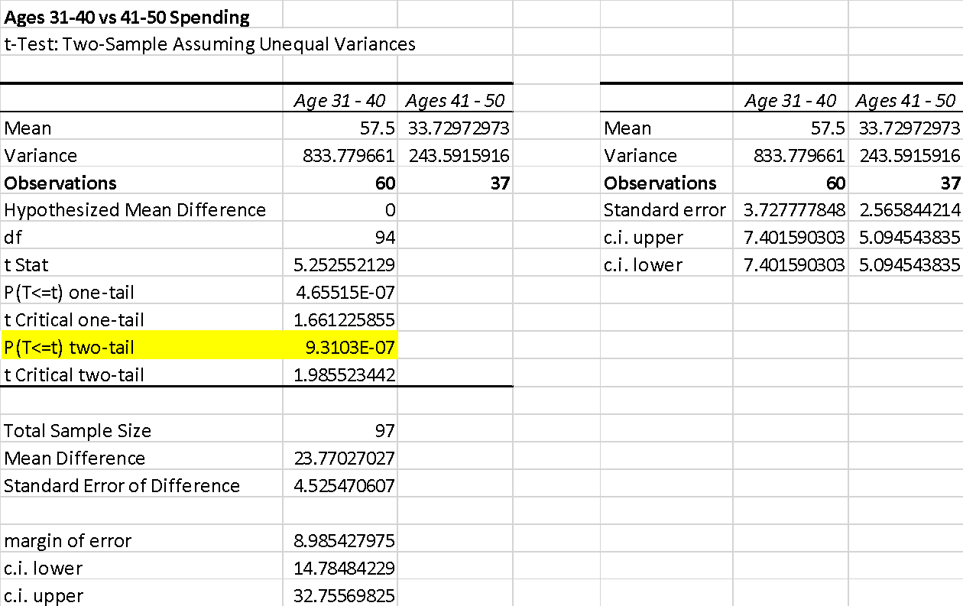
Additional statistical results
Hypothesis Test 2: Ages 31-40 vs 41-50

Slide 11
04
Recommendations
Notes:
We will now review recommendations based on the two hypothesis tests performed.

Slide 12
Recommendations
Hypothesis Test 1:
Female vs Male Spending
Hypothesis Test 2:
Ages 31-40 vs 41-50
Notes:
After analyzing the data on the amount spent between male and female mall customers with memberships, one recommendation is to target promotions to both equally. The data did not show enough difference in the amount spent to suggest targeting one over the other. Also, the mall owner should ensure the stores in the mall provide products and promotions equally to males and females to provide opportunity to achieve the highest sales and revenue.
Additionally, the analysis between people in their 30s compared to those in their 40s showed a significant difference in the amount mall customers spent, regardless of whether they are male or female, in that those in their 30s are spending more than those in their 40s.
Another recommendation is for the mall and stores in the mall to consider the age of the customers spending the most, when running promotions and ordering product, to attract them to the mall, which will provide the opportunity for higher sales and revenue.

Slide 13
05
Next Steps, Q&A
Notes:
Next. we will discuss possible next steps and answer any questions

Slide 14
Next Steps
New Data
Mall Stores
Promotions
Notes:
As part of the next steps with this analysis, it would be to the advantage of everyone to update this data to be as current as possible, ideally as of Q2 2021, but having the data through the end of 2020 will be helpful as well. With updated data, the current tests can be re-run and new tests could possibly be run. Everyone will then have a better idea of whether the tests performed in this analysis remain the same or if the results change. It will also help the mall and the mall stores to know if their efforts to attract customers are targeting the correct customers.
The second recommendation is to have a list of the stores in the mall along with their product category, product price range, and what they feel is their customer demographics (age, gender, etc). This will again help the mall to know whether to target males vs females and which age ranges are the malls best customers. By having this information, the mall can also try to attract people who are in the lower spending range in effort to get them to spend more and increase revenue.
It would also be helpful if the stores could provide when their sales/revenue is the highest excluding the Holiday/Christmas selling season to not skew the data. With this information, analysis could be performed for the mall to better run promotions to bring customers into the mall and the stores in order to increase revenue for both the mall and the stores. The mall could then run promotions when the stores have the lower revenue which will help increase customers coming to the mall.
In addition to the mall promoting the stores when the stores have the highest sales or the best promotions, the mall could work with the stores to promote the benefits of becoming a member of the mall. This should increase the mall revenue and will make it so customers want to come back to the mall and shop because of the membership rewards.

Slide 15
Q & A
Notes:
Are there any questions I can answer?

Slide 16
THANK YOU
Notes:
Additional results of these two tests can be found in the appendix along with links to the website where the dataset was downloaded, the Excel spreadsheet with the data used in the analyses along with the notebook used to run the test. A copy of this presentation will be emailed to everyone.
If you have any further questions, don’t hesitate to call or email me.

Slide 17
Appendix

Slide 18
Links
Link to the website where the file was downloaded:
https://www.kaggle.com/kandij/mall-customers
Link to the Excel file:
https://docs.google.com/spreadsheets/d/1N6WYChsGVTl0dYDfXCGSGrzNKwXu78BA/edit?usp=sharing&ouid=107830551552802508870&rtpof=true&sd=true
Link to the Colab Notebook:
https://colab.research.google.com/drive/13HlBbirhWxXIeU4w62EHxPPeBztjKbgN?usp=sharing

